Slide 1

NextGen AI Healthcare: Symptoms-based Diagnosis and Medical Rentals
FYP Final Defense Presentation
Supervised By:
Dr. Nasru Minallah
Group Members:
Muhammad Umar Jan 21PWCSE2000
Muhammad Saad 21PWCSE1997
Muhammad Zaid 21PWCSE1991
Muhammad Ilyas 21PWCSE2055
UNIVERSITY OF ENGINEERING AND TECHNOLOGY PESHAWAR DEPARTMENT OF COMPUTER SYSTEM ENGINEERING

Slide 2
Presentation Outline
Problem Statement
Brief Literature Review
Proposed Solution
Methodology Diagram
Milestone Achieved
Results
Conclusion and Future Work

Slide 3
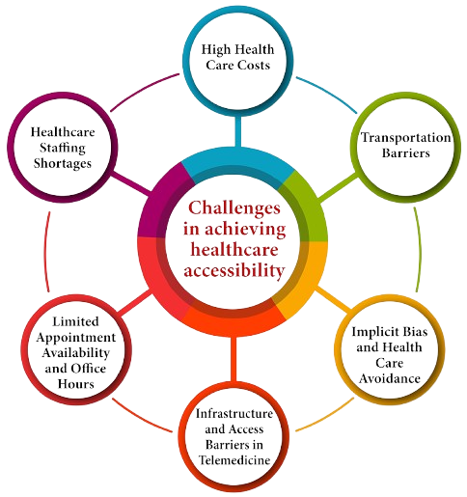
Problem Statement
Delayed diagnosis and lack of accessible medical guidance.
Scarcity of affordable medical equipment for patients at home.
Need for intelligent, scalable solutions for healthcare access.

Slide 4
Brief Literature Review
AI models (ANN, NLP) used in healthcare for diagnosis and assistance.
RAG architectures enhance chatbot relevance using domain-specific documents.
Device rental platforms can reduce healthcare costs and improve access.

Slide 5
Proposed Solution
Diagnosis System: ANN-based disease prediction, prognosis, and recommendations.
Chatbot: RAG-based system using Llama + FAISS for accurate medical responses.
Rental App: Flutter + Firebase app for secure medical equipment rentals.

Slide 6
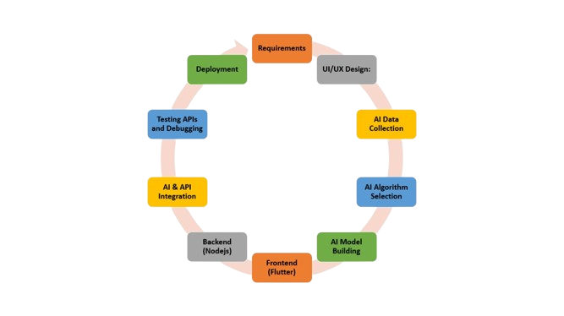
Methodology Workflow

Slide 7
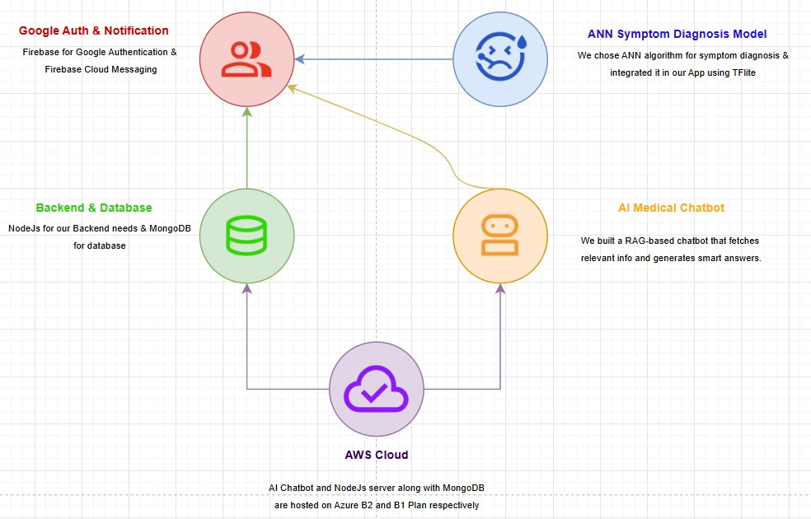
Methodology Tools
Data Collection: we used the dataset from Kaggle and preprocess it to generalize the model well during training. [1]
Compute: During ANN model training, we used Tensor Processing Units (TPUs) provided by Kaggle for accelerated computation.
Dev & Training: Developed in Python using VS Code and Kaggle, our system uses an ANN for symptom-based disease diagnosis and recommendations.
Front-end & Deploy: The system's frontend was built with Flutter and deployed using Node.js and Flask APIs for diagnosis and chatbot services.
Back-end & Data: Node.js with Express.js backend using MongoDB for user, item, rental, diagnosis, and payment data, secured with Google OAuth 2.0, Stripe payments integrated, deployed on Azure.

Slide 8
AI Symptoms Diagnosis -Flowchart
Data Loading And EDA
Feature Engineering
Model Building
Evaluation and Testing

Slide 9
Steps
Data Loading And Preprocessing
Exploratory Data Analysis (EDA)
Feature Engineering
Model Building
Evaluation
Challenges/Observations

Slide 10
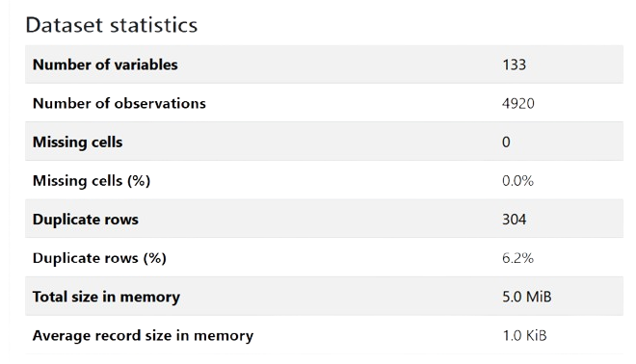
Data Statistics

Slide 11
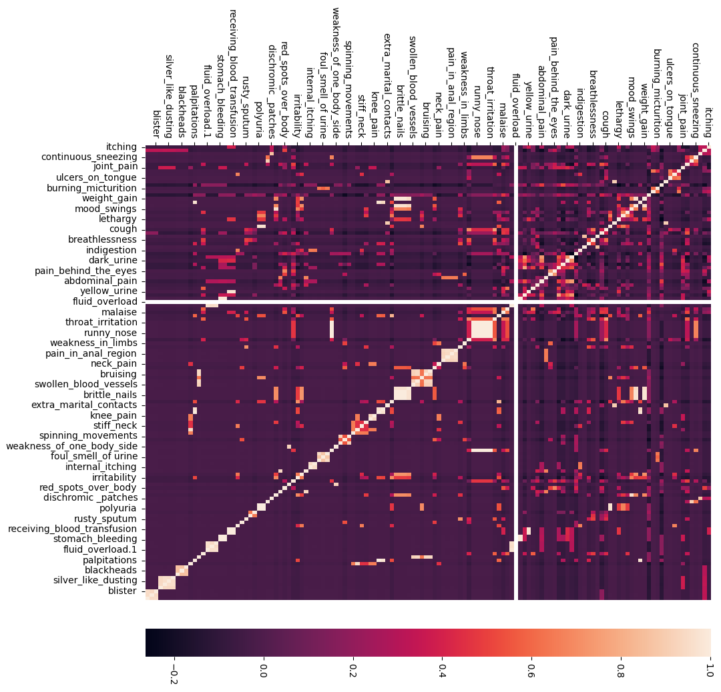
Correlation in-between features

Slide 12
Medical Chatbot
Semantic Search: User query is embedded using Sentence Transformers and matched against a FAISS index built from a medical PDF book.
Context Retrieval: Top relevant passages are retrieved and combined with the query for informed response generation.
Response Generation: Llama model via Groq API generates an accurate, context-aware medical answer within Seconds.

Slide 13
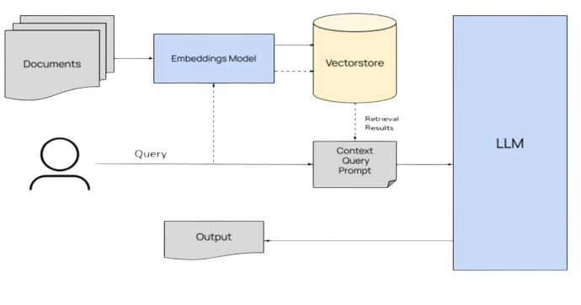
Pipeline of Chat-Bot

Slide 14
AI Diagnosis: Instant disease prediction, prognosis, and recommendations integrated using TFlite.
Medical Chatbot: RAG-based chatbot with PDF knowledge base (Groq + LLaMA) integrated using Flask API.
Live Device Listings: Real-time medical equipment rental via Flutter app.
Secure Login: Google OAuth 2.0 for secure authentication.
Data Security: Minimal storage, only medical item related data and user accounts stored in MongoDB while all chatbot interactions and symptoms stored locally.
Notifications via FCM Token: We use Firebase Cloud Messaging (FCM) to send instant, secure push notifications to users using device-specific FCM tokens.[5]
Image Hosting: All images hosted on Cloundinary.
APP Services

Slide 15
APP Database
Why NodeJS & MongoDB: We chose NodeJS and MongoDB for their robust features and ease of integration with Flutter.
Key Tables
Users : Manages account info (name, email, CNIC, profile pic), authentication, and preferences.
Items : Stores device details (name, description, images, price, availability).
Item Borrowed : Tracks rental activity (borrower, lender, dates, status, payment method).
Item Review : Holds feedback and ratings from users after renting items.
Wishlist : Lets users save items they're interested in renting later.
Challenges & Fixes
Real-Time Sync Delays: Occasional lags in data reflection were observed → implemented MongoDB change streams for real-time updates.
Schema Flexibility: Adding new fields caused compatibility issues with existing code → adopted version-controlled schemas using Mongoose with default values and conditional fallbacks.

Slide 16
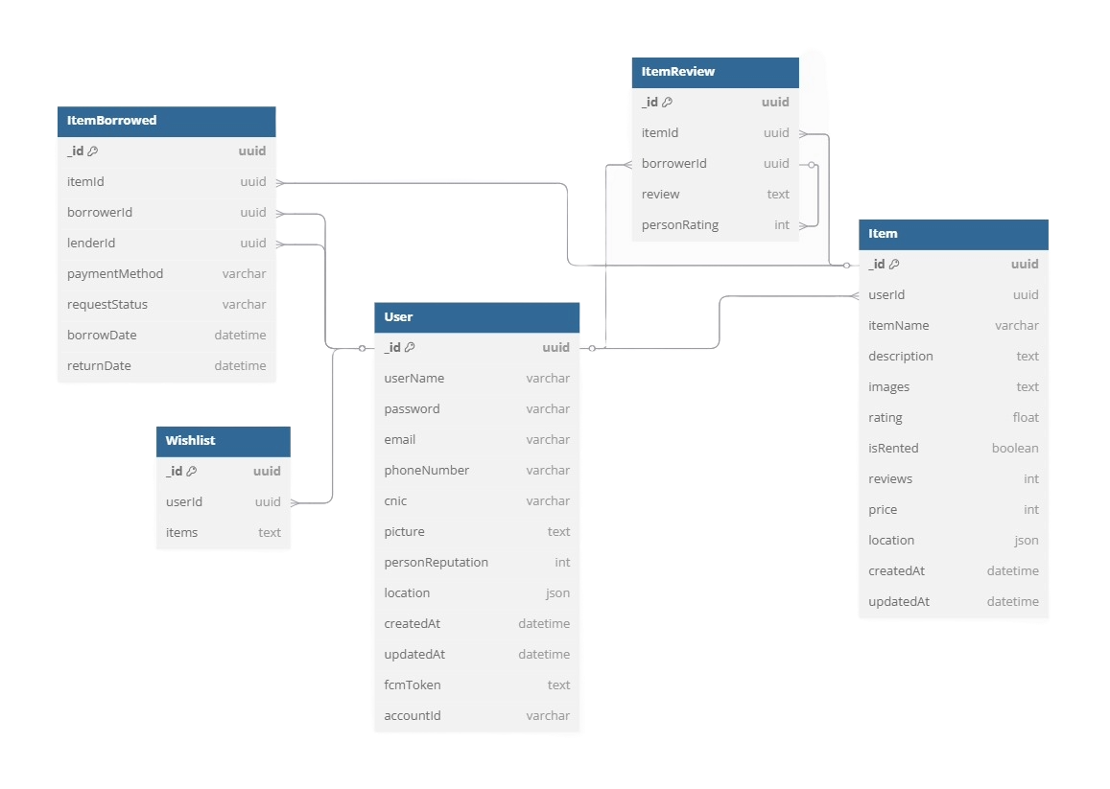
APP Database

Slide 17
Application Key Feature
AI Medical Diagnosis: Symptom-based disease prediction with ANN, prognosis assessment & treatment recommendations
Medical Chatbot: RAG-based AI chat using Llama (via Groq API) with semantic search over medical PDFs, integrated with app using Flask API.[3]
Device Rental System: Real-time browsing, renting & secure payments for home-use medical equipment.
User Profiles: Google login, account settings, order history & personalized wish lists
Rental Process Flow: Select device → Choose duration → Confirm payment → Track request status
Real-Time Notifications: Instant alerts for requests, approvals & return reminders via Firebase Cloud Messaging
Review & Ratings: Post-rental feedback system with star ratings to build trust and improve quality

Slide 18
Deployments
Backend on Edge Devices: Our Flask API and AI model server run on Azure's B2 plan, while the Node.js backend operates on the B1 plan. We scale up easily if needed.[7]
Frontend on Diawi: The Flutter-based frontend is distributed via Diawi for easy testing and installation, offering lightweight deployment and seamless integration for mobile devices[8].
Database on Cosmos DB : We store critical data locally using Cosmos DB on Azure , enabling real-time querying and synchronization.

Slide 19
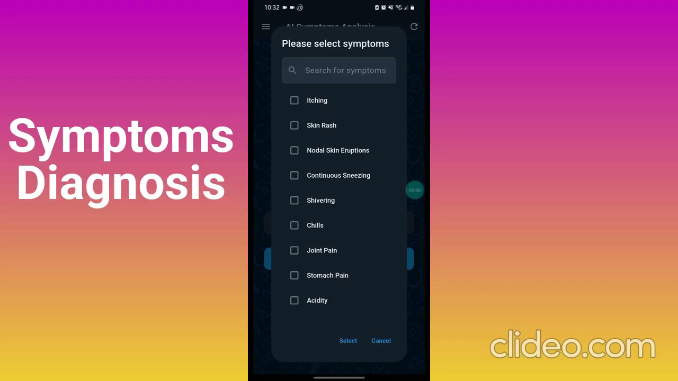
Video Demonstration

Slide 20
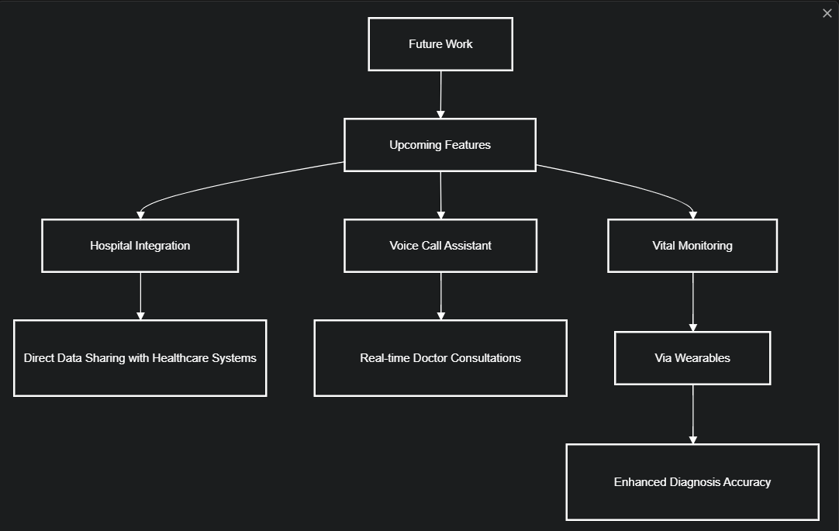
Future Work

Slide 21
References
[1] https://www.kaggle.com/datasets/noorsaeed/medicine-recommendation-system-dataset/data
[2]https://www.freebookcentre.net/medical_text_books_journals/medical_text_books_online.html
[3] https://groq.com/
[4] https://huggingface.co/?activityType=update-model&feedType=following
[5] https://firebase.google.com/docs/cloud-messaging
[6] https://pub.dev/packages/flutter_stripe
[7] https://azure.microsoft.com/en-us/products/deployment-environments
[8] https://i.diawi.com/E6uqCj

Slide 22
Thanks!
Do you have any questions?
umar2exe@gmail.com
+923179919987

